Slide 1
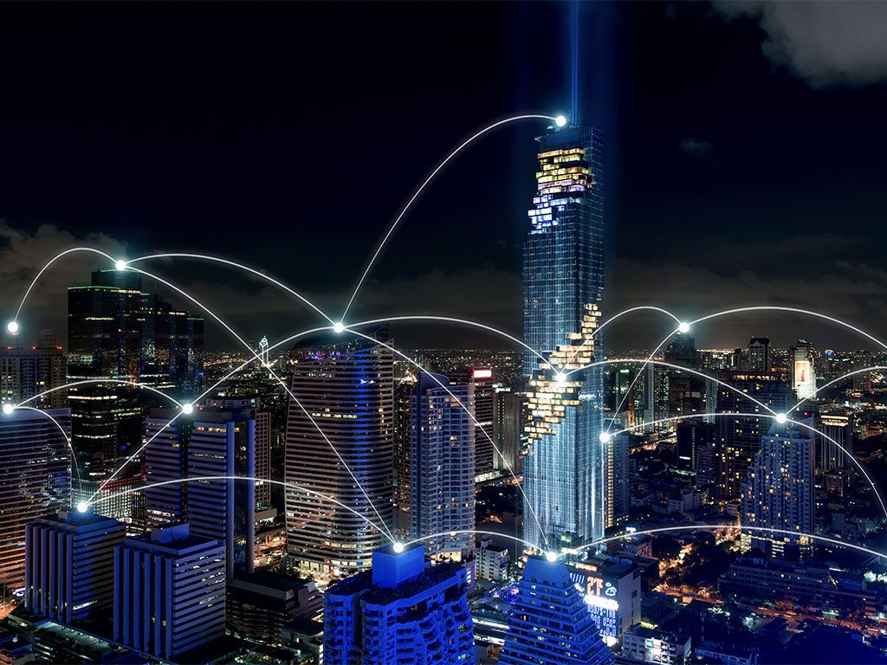
UNIVERSITY OF GHANA COLLEGE OF BASIC AND APPLIED SCINCES SCHOOL OF ENGINEERING SCIENCES DEPARTMENT OF COMPUTER ENGINEERING SMART CITY USING LORAWAN
BAMIEBO OBED NUMBO (10847868)
ANNAN MOSES (10845700)
SUPERVISOR: DR. MARGARET A. RICHARDSON
FEBRUARY 17, 2023

Slide 2

Presentation Outline
Introduction
Problem Statement
Objectives
Relevance of the project
Literature Review
Methodology
Resource Requirements and budget cost
Project Timeline
Individual responsibilities
Expected outcome
References

Slide 3
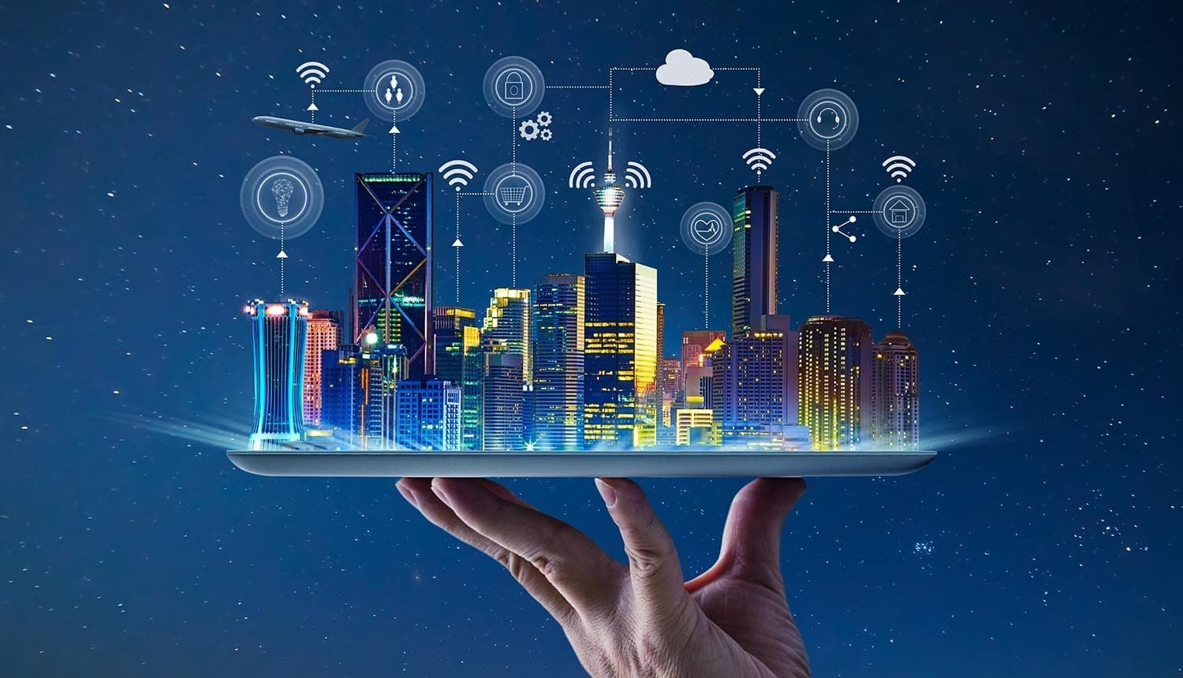
Introduction
Smart city leverages on connected technological devices to optimize city functions.
Smart city works alongside internet of things (IoT).
LoRaWAN, the smart choice network for IoT devices.

Slide 4
Problem Statement
Nine out of ten people from cities around the world breathe unclean air, which result in respiratory diseases, causing premature deaths.
Cities face challenges with transportation system, including heavy traffic congestion and long commute times.
Streetlighting cost 15 – 40% of the overall energy consumed in standard cities worldwide.
Water leakages lead to water contamination and wastage.

Slide 5
Objectives
Interface different sensors to collect different environmental data.
Transmit collected data to network server.
Analyse the collected data.
Make collected data accessible to government and appropriate management

Slide 6
Relevance Of The Project
Reduce traffic congestion and long commute times in cities to increase productivity.
Monitor road status to control street lighting to cut down energy usage and cost.
Improve public health.

Slide 7
Relevance Of Work (Cont’d)
Optimize city resources and services to improve city planning and management.
Assist individuals to make smarter decisions.

Slide 8
Literature Review
Ashish, J.,Menuka, M.,[1] proposed a smart lighting system using the LoRaWAN technology for streetlights that interfaces with other smart technologies. This technology, however, is only compatible with streetlights.
Chaudhari, P., Pattewar, S. et al[2] proposed a smart infrastructure monitoring using LoRaWAN to address sewage concerns in smart city environment. However, this system is limited to sewage.

Slide 9
Literature Review Cont’d
Jaime, J. et al [3] proposed a smart city sensor network based on LoRaWAN technology to collect data and manage assets and resources efficiently.

Slide 10
Proposed solution
Implement a smart city system to address traffic management, air quality, water leakage and energy usage challenges in cities. The system will include the following components:
Multiple sensors to collect data.
Gateways to forward data to network severs.
LoRaWAN network to transmit data securely.
Application server to provide functionality to end users.

Slide 11
Methodology
The system will comprise of four (4) main subsystems.
The sensor system: Multiple Lora sensor devices are programmed and configured and placed at points of interest to pick and read data.
The packet forwarder system: Gateways are configured to forward sensor data to a particular network server.

Slide 12
Methodology (Cont’d)
The network and application server system: LoRaWAN is used to transmit data securely to network server and application server.
The application system: Provide dashboard and functionalities to end users.

Slide 13
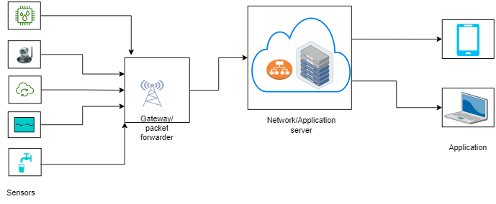
Architectural diagram

Slide 14
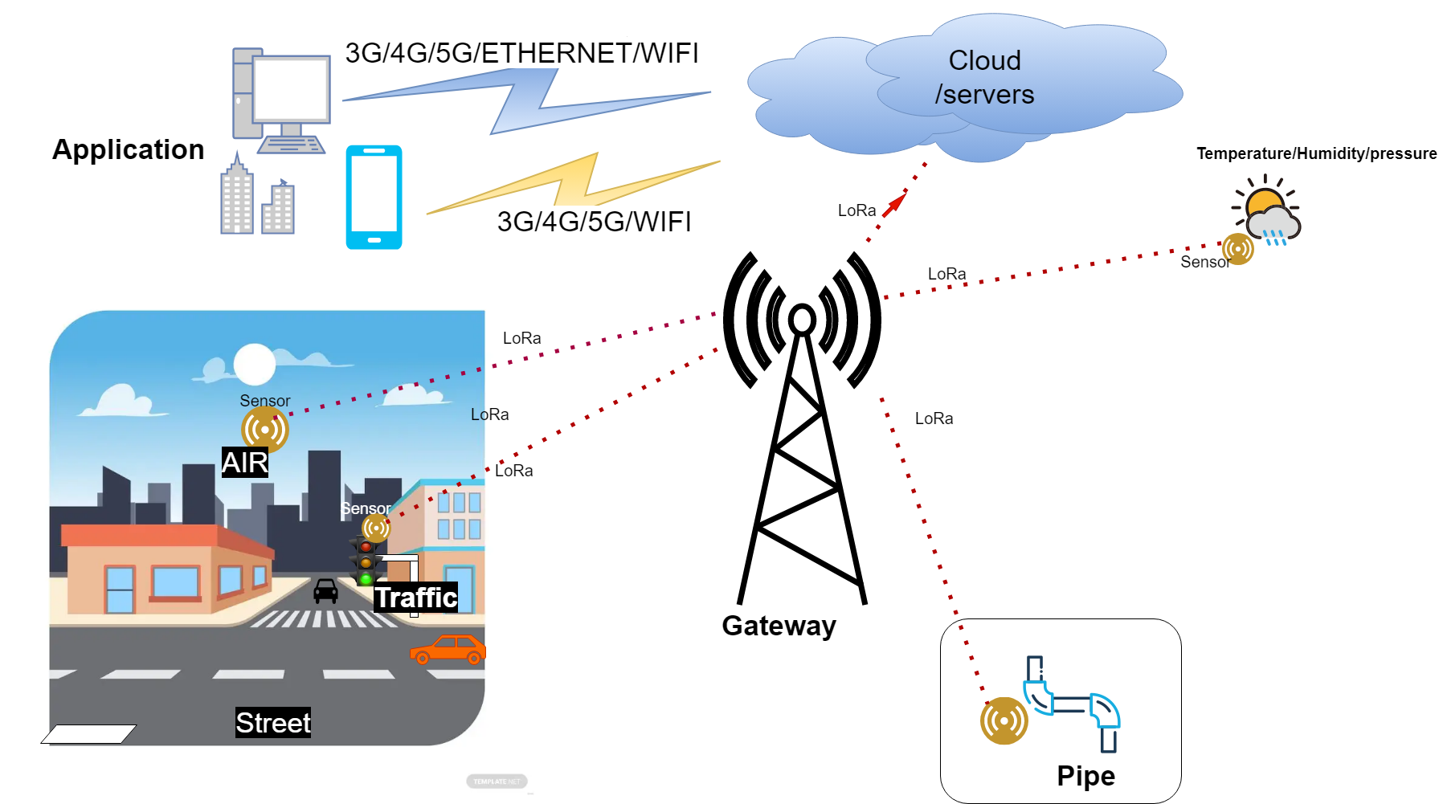
Architectural diagram (Cont’d)

Slide 15
Flow Diagram
Start
Initialize Sensors
Reading water sensor
Reading temp sensor
Reading air sensor
Reading Light Sensor
If>80%
Light intensity
Light OFF
If<80%
Update environmental
cloud data
Light ON

Slide 16
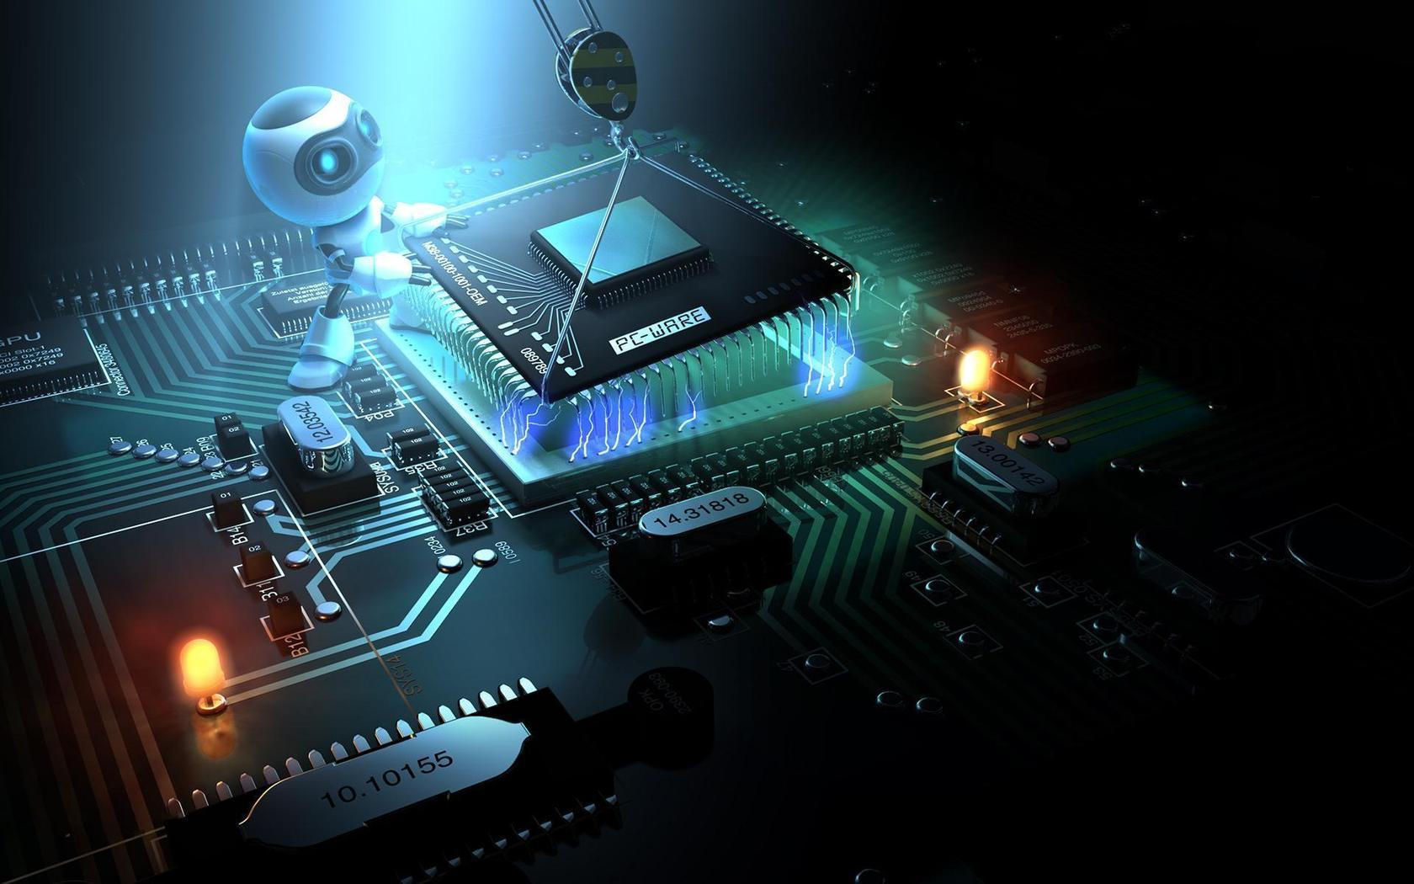
Resource Requirements
LoRa LF band sensor and gateway.
Computer
Antennas.
Ethernet with internet access.
5V battery
USB type-A and Micro-B cables.
STM32CubeIDE
STM32CubeProgrammer
Tera Term
ST-LINK utility

Slide 17
Budget cost
ITEM | COST ESTIMATE
LoRa LF band sensor and gateway. | GHS1500
USB type-A and Micro-B cables.
Software
5V battery x 6
Ethernet with internet access.
Other items

Slide 18
Project Timeline
Task No. | Task Name | Feb | Mar | Apr | May | Jun
1. | Data gathering & analysis
2. | System design
3. | Integration of the various systems and devices
4. | Testing and Validation of the solution
5. | Deployment of the solution
6. | Documentation

Slide 19
Roles and Responsibilities
Role | Assigned
Data gathering and analysis | Moses Annan & Obed Bamiebo
Sensor device configuration | Obed Bamiebo
Gateway Configuration | Moses Annan
Device connection | Moses Annan
Network Server Setup | Obed bamiebo
Application server setup | Moses annan
Testing and Validation | Obed Bamiebo & Moses Annan
Documentation | Obed Bamiebo & Moses Annan

Slide 20
Expected Outcomes
This project is expected to help address the challenges faced by cities today. The solution should be able to:
Monitor and control traffic flow in real-time to reduce congestion.
Monitor and control energy consumption in cities to improve efficiency.

Slide 21

Expected Outcomes Cont’d
Monitor air quality in real-time to protect public health.
Monitor and report water leakages in pipes.
Provide real-time information to citizens to improve their quality of life.

Slide 22
References
[1] Abdoulaye, P.,Zennaro, M.,Degila, J., & Pietrosemoli, E. (2019, February). A Smart Cities LoRaWAN Network Based on Autonomous Base Stations (BS) for some Countries with Limited Internet Access. Department of Information and Communications Technology, Institute of Mathematics and Physical Sciences, Porto-Novo 3730-301
[2] P. Chaudhari, A. K. Tiwari, S. Pattewar and S. N. Shelke, "Smart Infrastructure Monitoring using LoRaWAN Technology," 2021 International Conference on System, Computation, Automation and Networking (ICSCAN), Puducherry, India, 2021, pp. 1-6,
[3] J. Jaime, I. Sousa, M. P. Queluz and A. Rodrigues, "Planning a Smart City Sensor Network Based on LoRaWAN Technology," 2018 21st International Symposium on Wireless Personal Multimedia Communications (WPMC), Chiang Rai, Thailand, 2018, pp. 35-40

Slide 23
References
Ramesh, R.,Arunachalam, M.,Atluri, K. H., Kumar, C., Anand S.V.R., Arumugam, P., Amrutur, B., (2020, March). LoRaWAN for smart cities: experimental study in a campus deployment. LPWAN Technologies for IoT and M2M Applications, Academic Press (pp. 327-345).
Anzum, R., (2020, January). LoRaWAN Technology on Air Quality Monitoring for Public Health Protection. World Journal of Environmental Biosciences.

